Slide 1
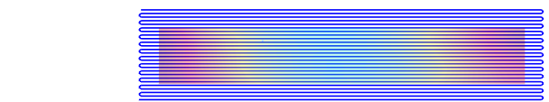
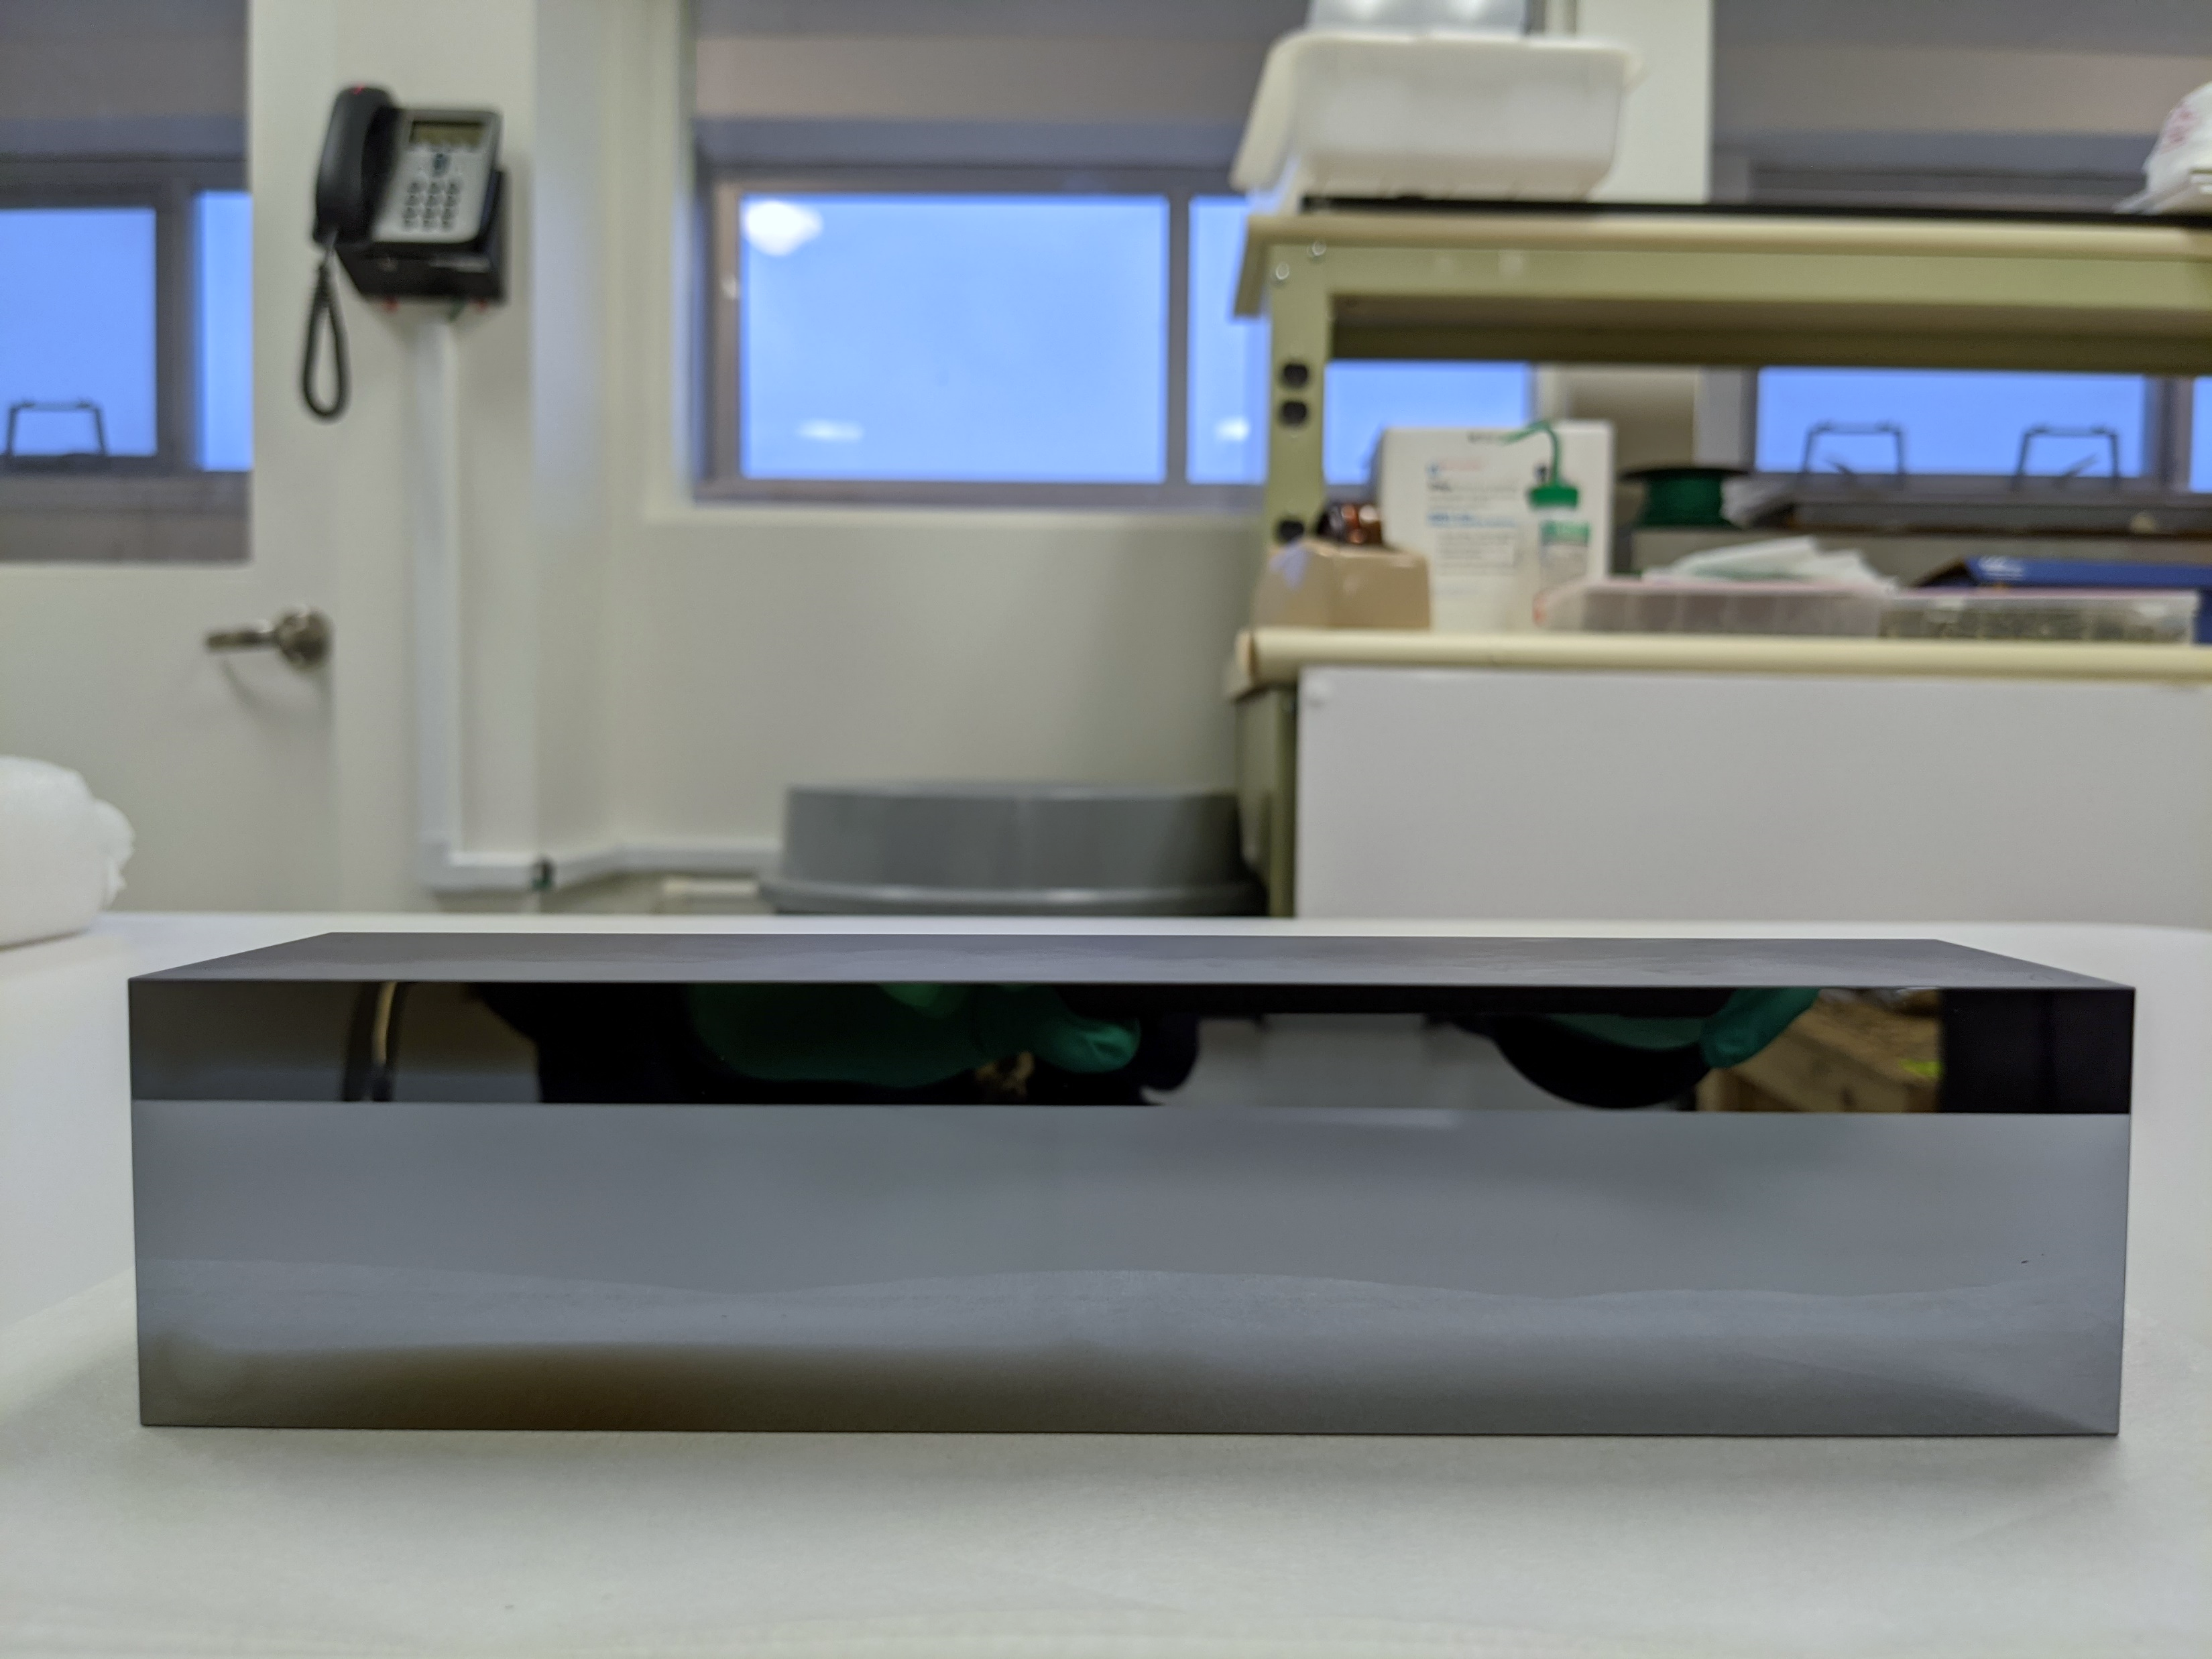
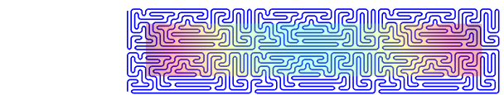
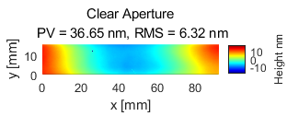
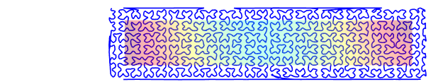
(c)
Raster path
26 mm
(a)
102 mm
(d)
Maze path
26 mm
(b)
Target removal map, RMS = 6.32 nm
[nm]
102 mm
10
16 mm
(e)
RAP
-10
92 mm
26 mm
102 mm

Slide 2
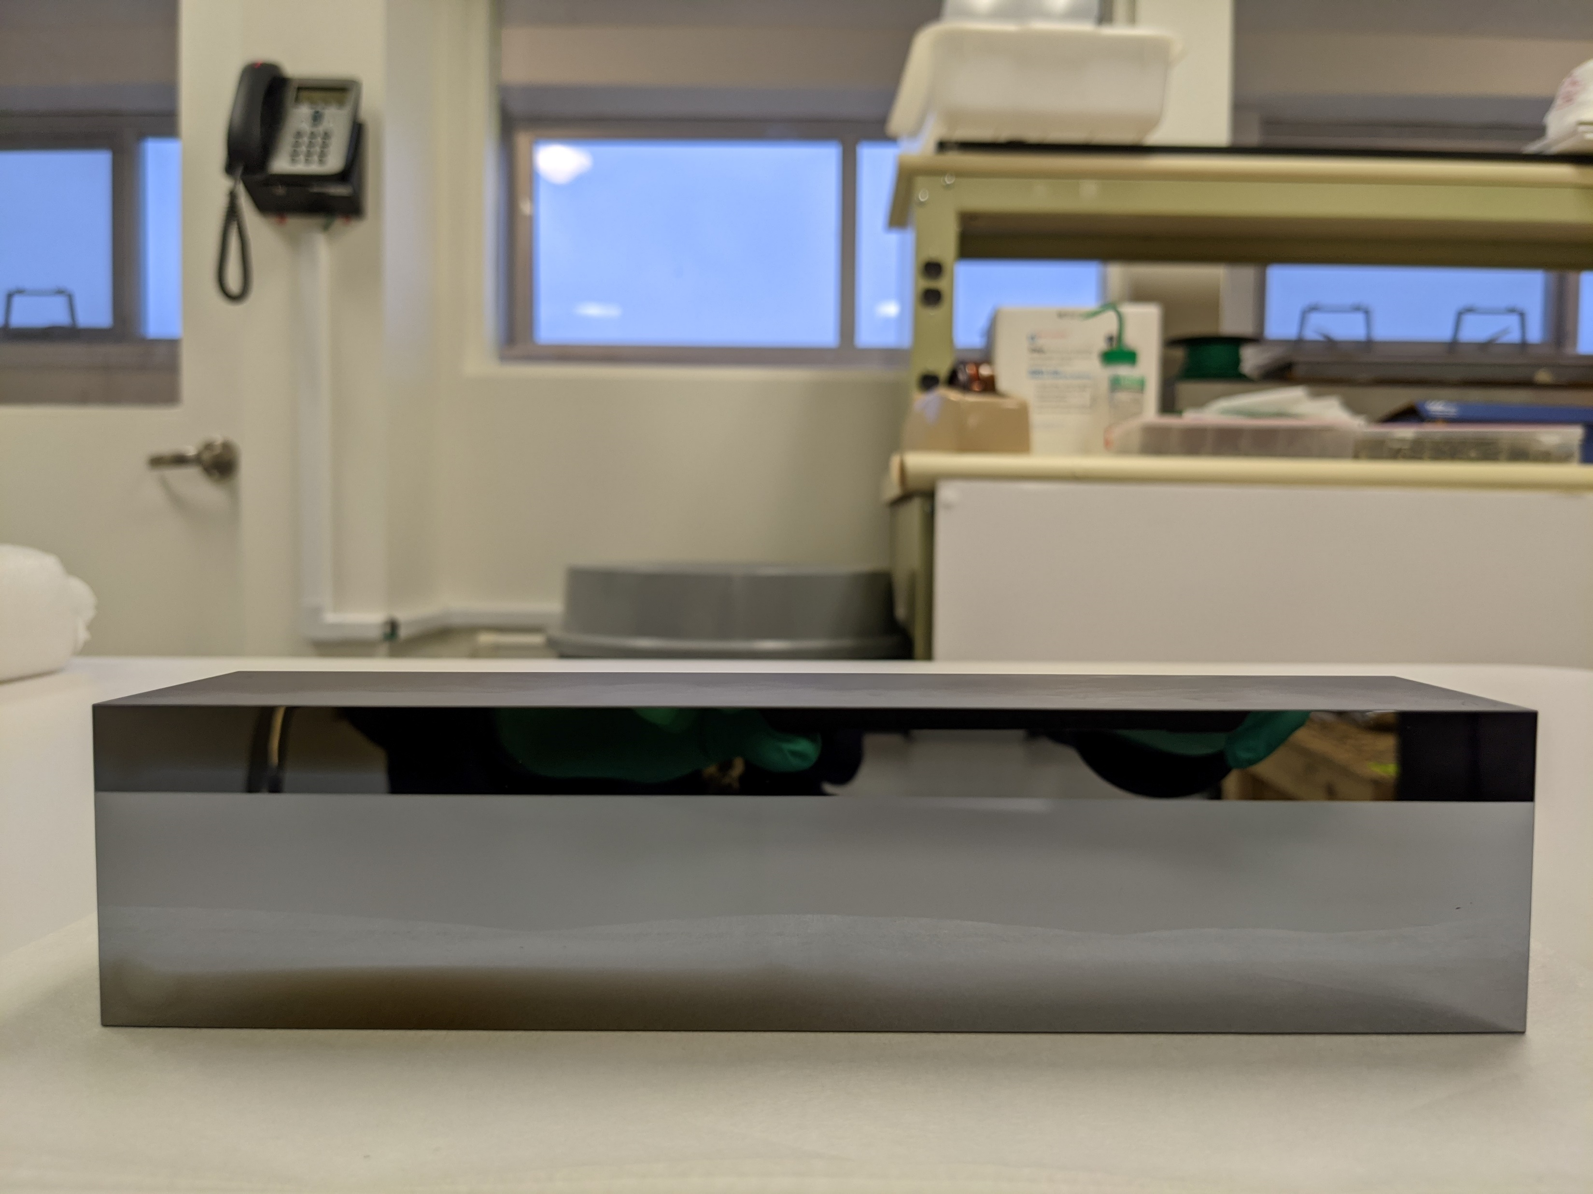
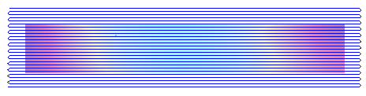

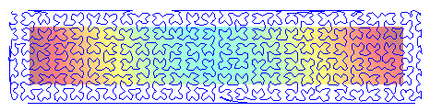
(a)
Target removal map, RMS = 6.32 nm
[nm]
10
(b)
16 mm
-10
92 mm
Raster path
(c)
25 mm
102 mm
Maze path
(d)
25 mm
102 mm
RAP path
(e)
25 mm
102 mm

